Slide 1
FY2018
Town’s Operating Budget

Slide 2
FY 2018 Operating Budget
The FY 2018 Operating Budget is mostly a LEVEL SERVICE budget with nominal increases.

Slide 3
FY 2018 Collective Bargaining Agreements
Collective bargaining agreements with all five (5) unions have not been negotiated and are not funded in this budget. The Town may need to appropriate additional funds for contract settlement for the upcoming fiscal year.

Slide 4
FY18 General Stabilization Fund
The proposed budget is balanced without withdrawing from the General Stabilization Fund, which has been the goal of the last two (2) budgets. (FY17 & FY18)

Slide 5
10 Years Stabilization Fund
FY07 | 222,546
FY08 | 208,574
FY09 | 71,601
FY10 | 77,705
FY11 | 42,960
FY12 | 303,439
FY13 | 293,738
FY14 | 358,601
FY15 | 1,049,311
FY16 | 657,641
FY17 | 802,000

Slide 6
10 Years Stabilization Fund

Slide 7
FY18 Budget Line Item Increases
Budget proposed amounts to 306,231.31 increase (2.22%)
% Chg.
General Government $12,291.59 1.20%
Land Use ($13,353.71) -4.54%
Protections of Person/Property $33,075.65 2.48%
Regional Schools $282,964.34 3.60%
Department of Public Works ($28,640.71) -4.54%
Library and Citizen Services $2,631.29 0.74%
Debt Service ($4,077.00) -0.73%
Employee Benefits $21,339.86 1.50%
TOTAL $306,231.31

Slide 8
FY18 Budget Highlights
General Government
Land Use
Protection of Persons and Property
DPW
Library and Citizen Services

Slide 9
5 Fiscal Year Expenditure Comparison
FY 14 FY18 $ Change % Change
General Government $958k $1M $78k 8.23%
Land Use $242k $280k $38k 15.75%
Protection of Person and Property $1.2M $1.3M $121k 9.73%
Regional Schools $6M $8.1M $2.1M 34.83%
Department of Public Works $659k $602k ($57k) -8.68%
Library and Citizen Service $378k $359k ($19k) -5.19%
Debt Service $703k $551k ($152k) -21.69%
Employee Benefits $1.2M $1.4M $193k 15.50%

Slide 10
FY 18 Regional School Increase

Slide 11
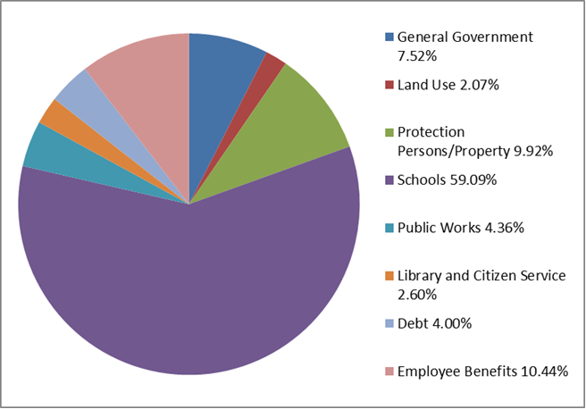
FY 18 Expense %

Slide 12
5 Fiscal Year Revenue Comparison

Slide 13
5 Fiscal Year Local Receipts
ACTUAL | ACTUAL | ACTUAL | BUDGETED | ESTIMATED
FY 2014 | FY 2015 | FY 2016 | FY 2017 | FY 2018

Slide 14
FY 18 Revenue Summary

Slide 15
FY 18 REVENUE %

Slide 16
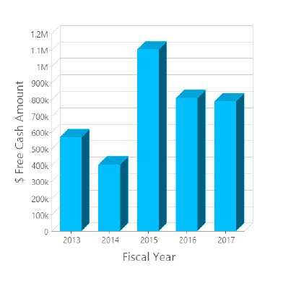
5 Fiscal Year FREE CASH
1.1M
$808k $789k
$571k
$403k

Slide 17
FY 18 Capital
The FY 2018 Capital Budget total:
$493,761

Slide 18
Conclusion
FY 18 BUDGET ONLINE TOWN WEBSITE
Level Service Budget
Balanced without using reserves
Less dependence on one time revenue
Union contract negotiations
Strong undesignated fund balance and reserves
FY19:
Regional Dispatch; Long Term Borrowing; Grants; School Assessment; Capital Needs

